Slide 1
The first neural network
James H. Faghmous, Ph.D.

Slide 2
Part II:
The Perceptron

Slide 3
Part II: The Perceptron
The Machine Learning Formula
Choose Family of Models
Estimate parameters
Q3
Reduce complexity

Slide 4
Part II: The Perceptron
Family of Models
Linear | Non-Linear | Deep | Probabilistic | Ensembles
Regressions | Trees | Convolutional neural networks | Naive Bayes | Forests
Support Vector Machines | Kernel Methods | Recurrent neural networks | Graphical Models
Perceptron | Neural networks | Auto encoders
 |  | Restricted Bolzmann machines

Slide 5
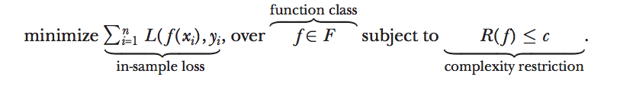
Part II: The Perceptron
Machine learning in a nutshell
“Minimize loss over function class subject to regularization”
Mullainathan, Sendhil, and Jann Spiess. "Machine learning: an applied econometric approach." Journal of Economic Perspectives 31.2 (2017): 87-106.

Slide 6
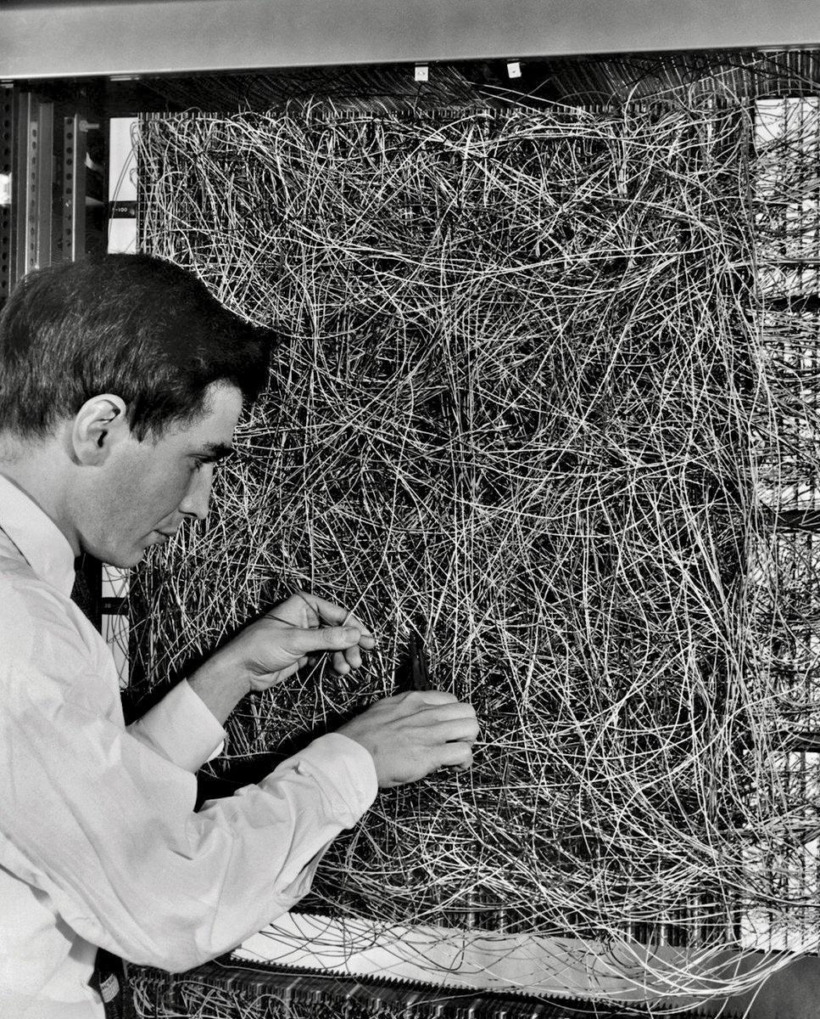
Part II: The Perceptron
The Perceptron
Created in 1956 by Dr. Frank Rosenblatt at Cornell
This was a physical machine (i.e. hardware)
The intuition was that the output was a function of a linear combination of the inputs!
Think of it as iteratively turning knobs on a screen until the image is crisp
More on the Perceptron

Slide 7
Part II: The Perceptron
A new problem
You work at PayPal in Santa Monica and are tasked by detecting any fraudulent transactions being made on the platform
You are given a large set of historical transactions with various characteristics (e.g. amount, time of day, country, etc.) and a label whether it is fraudulent or not
More on the Perceptron

Slide 8
Part II: The Perceptron
A new problem - some notation
Input: X (transaction information - one transaction per row)
Output (label): y (Fraud or Not Fraud)
Target function: f (ideal fraud detection function)
Training data: (x₁,y₁), (x₂,y₂),..., (x_{N},y_{N}) (historical records of both fraudulent and non-fraudulent transactions)
Hypothesis g: X → y (the formula that maps inputs X to output y to be estimated from the historical data)

Slide 9
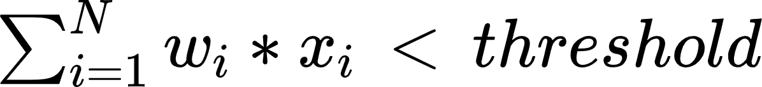
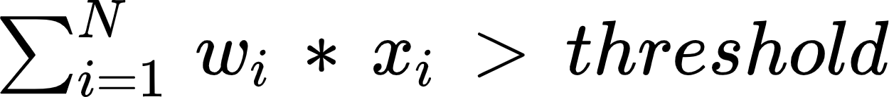
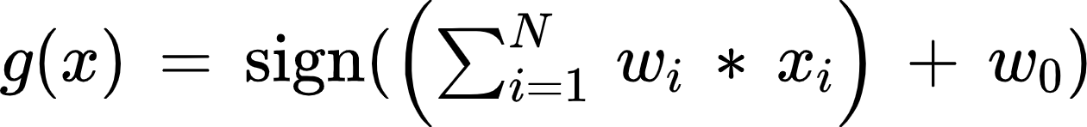
Part II: The Perceptron
A new problem - some notation
For input: X (transaction information - one transaction per row):
Approve transaction if
Reject if
This can be rewritten as:
Why do we add w₀

Slide 10
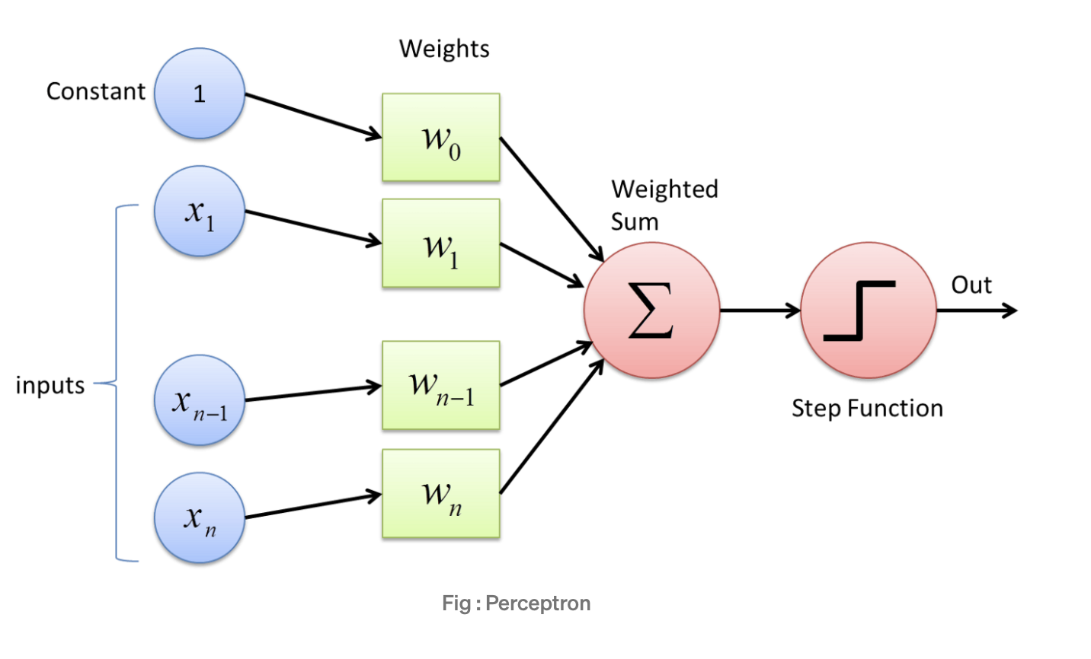
Part II: The Perceptron
The perceptron visually
Source

Slide 11
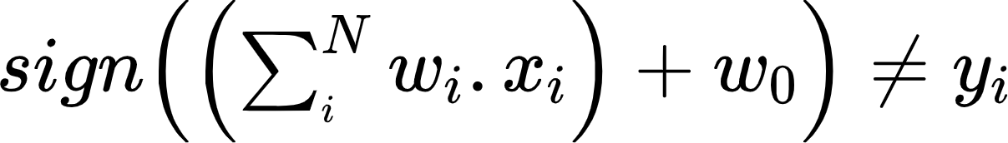
Part II: The Perceptron
The Perceptron Algorithm
Given the historical examples (training set) (x₁,y₁), (x₂,y₂),..., (x_{N},y_{N})
Set w₁, w₂, …, w_{N} randomly
If
Update w: w + (y`-y_{i})x_{i}
Repeat until no more misclassified points
That’s it!
Live demo

Slide 12
Part II: The Perceptron
The Perceptron Algorithm
The key ingredient is the Perceptron Update Rule: w ← w + (y`-y_{i})x_{i}
But how does it work?
The secret to this rule being so effective is the assumption that the data are linearly separable (i.e. the positive examples are mostly one side and the negative examples on another!)
Live demo

Slide 13
Part II: The Perceptron
The perceptron summary
The perceptron is a linear binary classifier
You can use other methods to estimate the weights
You can use other activation functions (other than the step function)
Neural networks are nothing more than multi-layer perceptrons!

Slide 14
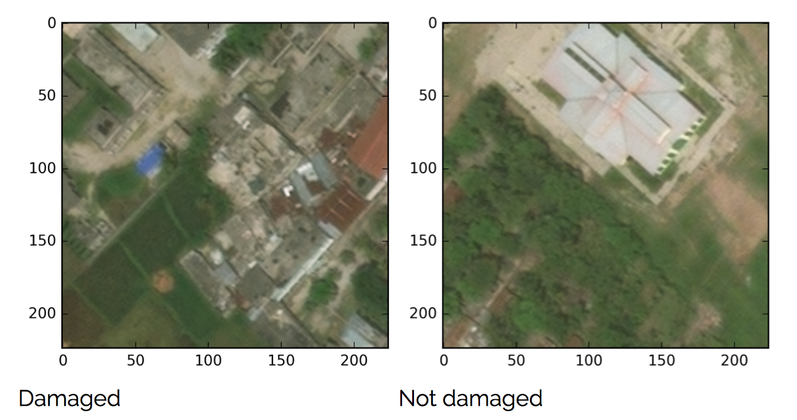

Part II: The Perceptron
Can we identify damage from space?
Data Science
at The Arnhold Institute

